Slide 1
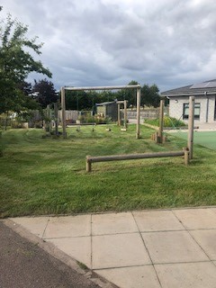
School Improvement Plan
Laurencekirk School

Slide 2
Highlights from 2020/2021: Promote a high quality learning experience
More outdoor learning taking place in school
Talk for Teaching introduced and embraced by all staff – this enabled staff to talk together about learning and teaching and generate new ideas.
Cluster transition groups set up with staff from Mearns and other primary schools to discuss learning, teaching and achievement this helps us to develop our skills and consistency of quality across our schools.
All staff engaged in training for Making Thinking Visible which helped teachers to create a culture of thinking in our classrooms.
Some classes trialled See Saw and it was very successful in sharing learning.

Slide 3
Highlights from 2020/2021: Approaches to develop literacy and numeracy skills
Emerging Literacy Project introduced in Primary 1 to support the teaching of early literacy skills.
All staff engaged in training linked to Mastery in Mathematics meaning that all children work through similar content in their classrooms at a depth of difficulty matched to their needs and abilities.
Concrete materials were purchased to help our children develop key mathematical concepts.
We developed an approach to shared and guided reading and purchased resources to enhance the teaching of reading.

Slide 4
Highlights from 2020/2021: Ensure learners develop skills for learning, life and work
We purchased ipads for each level in the school to increase the access to digital technology for our pupils and support the children to profile their own learning in See Saw.
Primary 6 made visits to the Residential Home which strengthened our links with the community and allowed our children to learn across generations.
Our gardening club runs with the local MHLN group.
Primary 5/6 met with the local Dementia Group each term to play games and socialise together.

Slide 5
Highlights from 2020/2021: Improve social and emotional wellbeing
Some of our staff engaged in nurture training which helps us to support our children to feel safe and included in school.
Through watching a ‘Resilience’ film all our staff developed their understanding of adverse childhood experiences and how these can impact upon a child’s behaviour.
We worked as a school community to identify our core values of respect, resilience, relationships and responsibility.
We worked together to identify the consistent rules of Be ready, Be safe and Be respectful. We also devised a behaviour blueprint to be shared across all classes to foster consistency of approach in promoting positive relationships in our school.

Slide 6
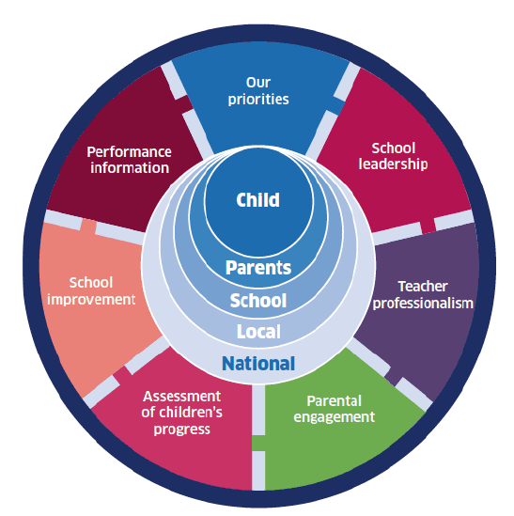
National Improvement Framework
Improvement in attainment in literacy and numeracy
Closing the attainment gap
Improvement in Health and Wellbeing
Improvement in employability skills.

Slide 7
School Improvement Priority 1
Design a recovery Curriculum
Outdoor learning
Refresh and Review Reporting Calendar
Family Learning Opportunities linked to HWB, SHANARRI, skills, rights of the child, literacy (emergent literacy)
To improve attainment
Consistent approach to tracking and monitoring and looking at data together
Emerging Literacy Programme from Nursery to Primary 2
IEP consistent approach across the cluster
SRRT: develop the use of CIRCLE resource to support universal support in classrooms

Slide 8
School Improvement Priority 2
SHANARRI introduced across the community to understand wellbeing
Rights Respecting School
Calm corners throughout the school and worry trees in the playground
Embed Talk for Teaching
To improve health and wellbeing
Zones of Regulation
Solution Focused Approaches
Emotion Coaching
Autism/anxiety friendly classrooms
Embed values to create a shared language
Review behaviour blue print
Eco Schools
Develop and excellence and equity strategy

Slide 9
School Improvement Priority 3
Refreshed approach to enterprise
Create a curriculum map for recovery
Life skills award across the school linked to family learning
Ensure learners develop the skills for learning, life and work
Inter-generational work and partnership work to be developed
Creating leadership opportunities in Second Level using Career Education entitlements
HGIOURS, RRS and Eco group to support pupil voice in self evaluation
Digital progressions developed as part of the recovery curriculum which includes a digital passport

Slide 11
PEF Funding….
Targeted approaches to Literacy
Read Write Inc
Toe by Toe
Early Intervention and Prevention
Emerging Literacy support
Interventions for Equity
Social and Emotional Wellbeing
Nurture
Proprioceptive sensory input
Snack and story sessions
Pupil Support Worker
Promoting a high quality Learning experience
Digital skills
Outdoor learning training for all staff

